Slide 1
Testing Frameworks Workshop
Dominic Tippabattuni

Slide 2
Contents
Introduction
Test Pyramid
Unit Testing
Test Doubles – (Mocks & Stubs)
Serenity
Selenium
Rest Assured

Slide 3
Why Test Automation?
Discussion…

Slide 4
Introduction – Advantages
Improved Accuracy / Reliability
Quick Feedback
Fast Execution of Tests
Reusability
Documentation
Improves work-life balance
Increases Developer confidence

Slide 5
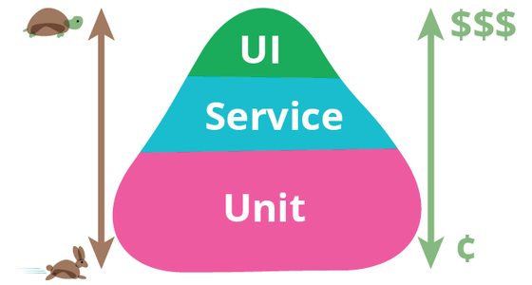
Test Pyramid - Martin Fowler

Slide 6
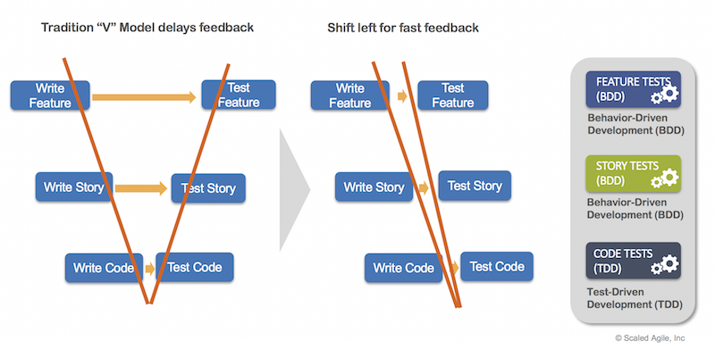
Testing Approaches

Slide 7
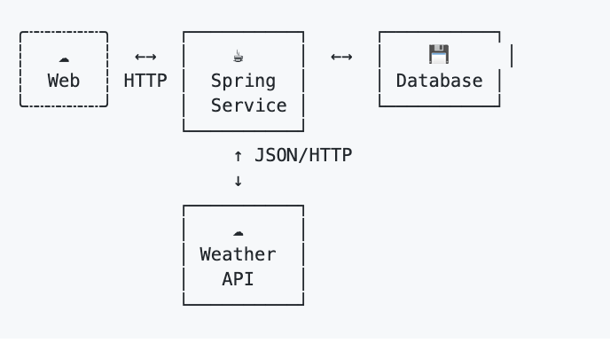
Sample Application Architecture

Slide 8
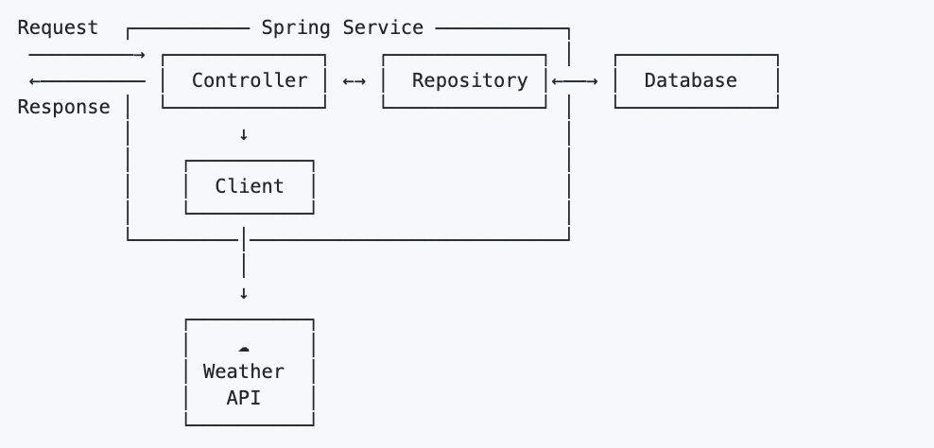
Internal Architecture

Slide 9
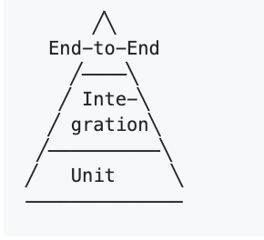
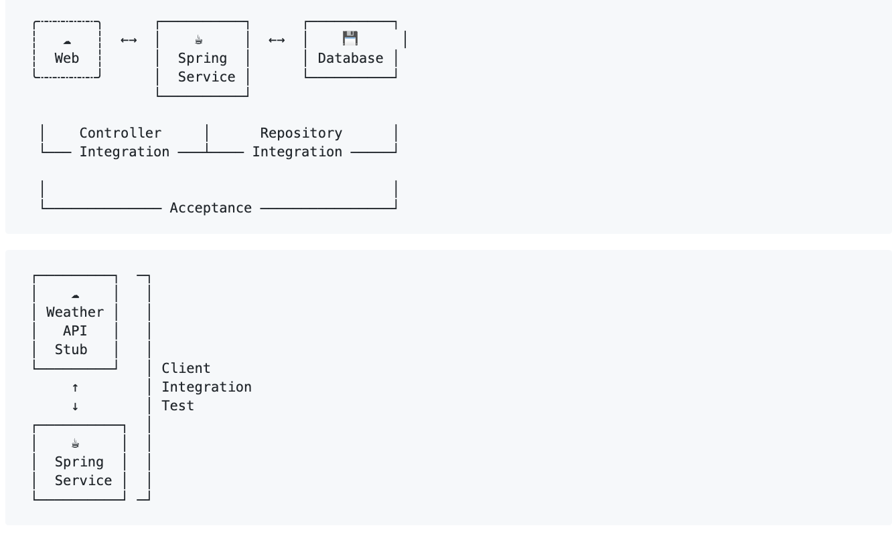
Test Layers

Slide 10
Learning Model
UI/Web Services Testing Frameworks
Mocking Frameworks
OOP Design Patterns / Unit Testing Framework

Slide 11
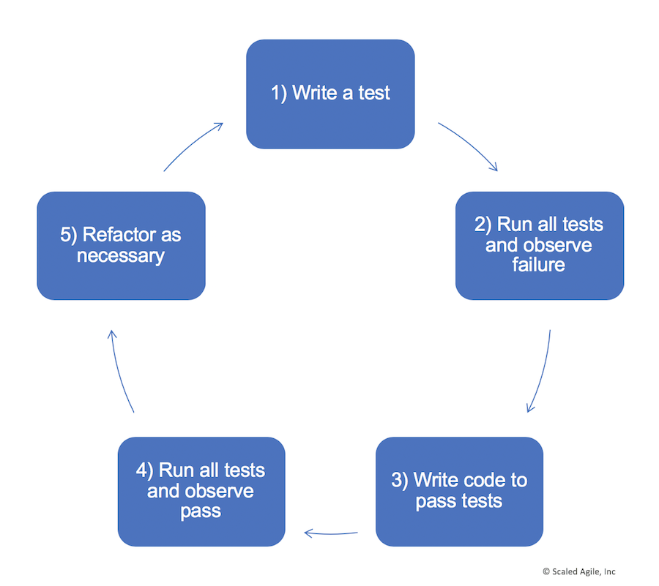
Test Driven Development

Slide 12
Junit 5 - Features
Assertions
Assumptions & Conditional Execution
Annotations
@Test, @DisplayName, @ParameterizedTest, @Disabled
Parallel Execution

Slide 13
Junit 5 – Demo
Maven Dependencies
Simple Test Case
Junit 5 Lifecycle
https://github.com/dtippabattuni/intro-junit5

Slide 14
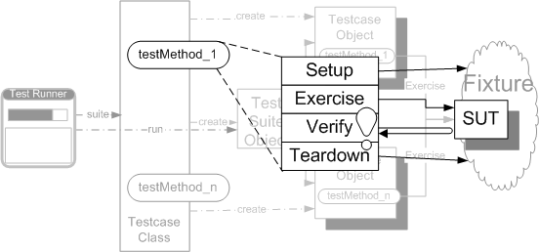
Standard Test Phases

Slide 15
Mockito - Features
Tasty mocking frameworks for unit tests in Java
Mocks concrete classes as well as interfaces
Test Doubles
Mocks – Verifies if an object is being used correctly
Stubs – returns values
Fakes – objects that have working implementations but not production ready
Common targets – Web Serivces, Db Connections, Complex classes

Slide 16
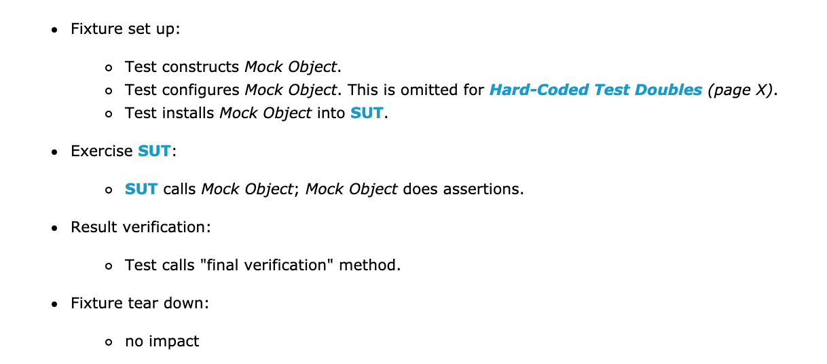
Standard Test Phases with Mocking
Setup
Exercise
Verify
Tear Down

Slide 17
Mockito - Lab
https://github.com/springframeworkguru/testing-junit5-mockito

Slide 18
Code Review…
https://github.com/hamvocke/spring-testing
Spring Boot: application framework
JUnit: test runner
Hamcrest Matchers: assertions
Mockito: test doubles (mocks, stubs)
MockMVC: testing Spring MVC controllers
RestAssured: testing the service end to end via HTTP
Wiremock: provide HTTP stubs for downstream services

Slide 19
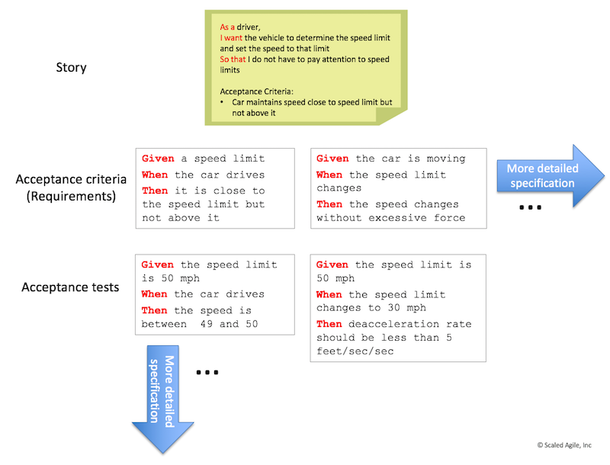
Behavior-Driven Development

Slide 20
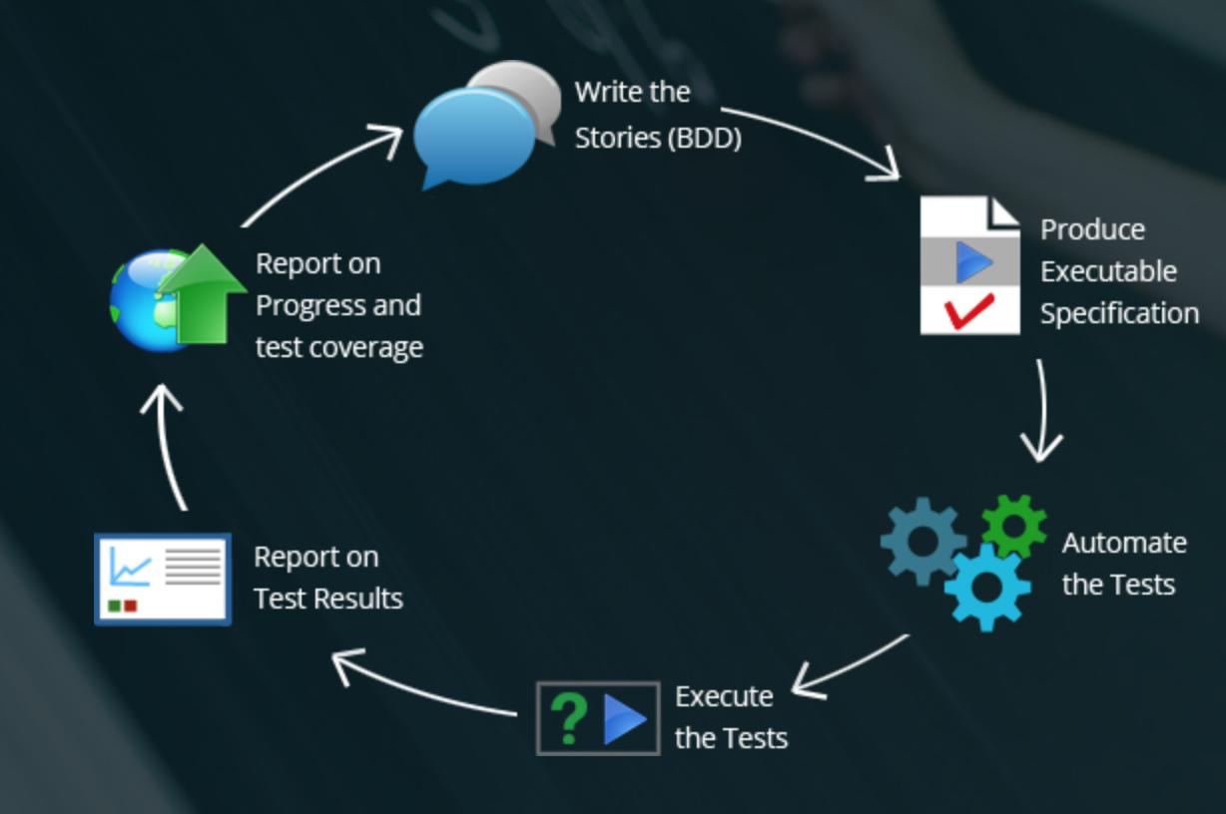
Behavior Driven Development

Slide 21
Serenity Features
BDD support – Cucumber & Jbehave
Implements popular testing design patterns - ScreenPlay, PageObject
Has integration with Selenium (UI) & Rest Assured
Supports Screenshots & Reporting
Other integrations – springframework,

Slide 22
Serenity Demo

Slide 23
Tests Organization
Maintain Unit Tests and Integration tests within the main project
Unit Tests are executed by maven-surefire-plugin
Integration Tests are executed by maven-failsafe-plugin
Maintain Functional Tests or BDDs as a separate project

Slide 24
Key take away…
In Agile Software Development, testing is Software Developer responsibility!
Practice
Test Driven Development (TDD)
Behavior Driven Development (BDD)

Slide 25
References
https://martinfowler.com/bliki/TestPyramid.html
https://github.com/hamvocke/spring-testing ( Sample Application )
https://www.udemy.com/testing-spring-boot-beginner-to-guru
https://www.udemy.com/testing-spring-boot-beginner-to-guru
https://automationrhapsody.com/mock-junit-tests-mockito-example/
http://xunitpatterns.com/Mocks,%20Fakes,%20Stubs%20and%20Dummies.html
http://xunitpatterns.com/Mock%20Object.html

